Slide 1
Chinese GA Market
International Cooperation
Zhang Feng
Secretary General
AOPA-China

Slide 2
Introduction of AOPA-China
Overview of Chinese GA Market
Next Steps
CONTENTS
International Cooperation

Slide 3
Introduction of AOPA-China

Slide 4
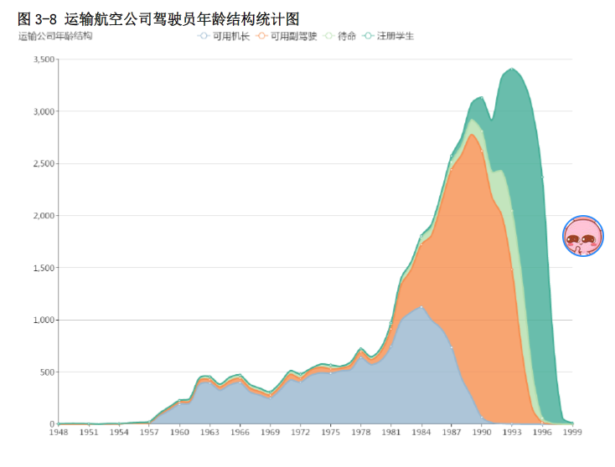
Birth Year of Pilots

Slide 5
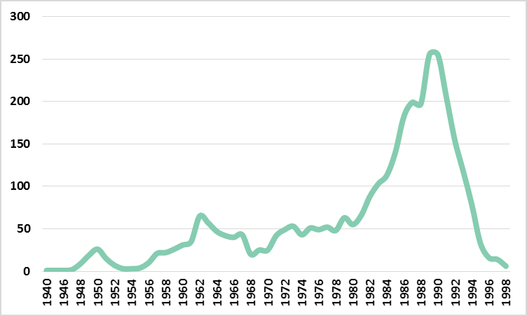
Birth year of GA pilots

Slide 6
AOPA-China
2004
Approved by the state council of China, work hand in hand with CAAC.
Becomes a very influential association.

Slide 7
Organizational Structure
General Assembly
Board of Directors
Expert Committees
Advisory Board
Secretariat
General Affairs Department
Accounting Department
Membership Department
Development & Planning Department
UAS Affairs Department
International Affairs Department
Publicity Department
GA Business Department
Standard Research Center
Airworthiness Certification Department
Aviation Product & Culture Department

Slide 8
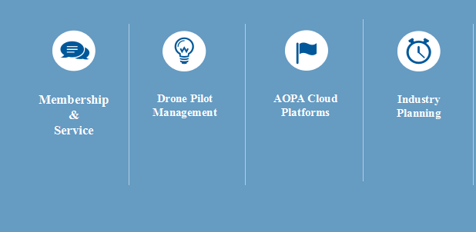
Work scope
Membership
&
Service
Drone Pilot
Management
AOPA Cloud Platforms
Industry Planning
Group Standard
国际事务
参与通航国际事务
组织国际交流活动

Slide 9
AOPA-China
Over 10000 individual members
Membership
100 corporate members
Service
UAS Pilots management
UAS Pilot training schools
Projects

Slide 10
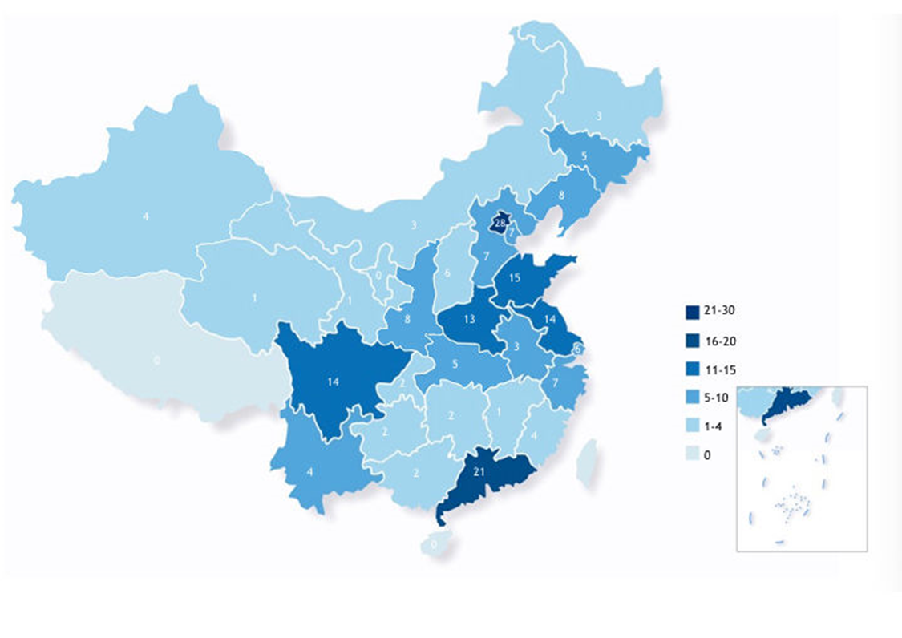
AOPA-China
Over 200 UAS pilot training institutions
Over 20000 UAS Pilot certificates
Capital of UAS industry in China

Slide 11
Highlighted Activities
AOPA -China International Flight Training Exhibition——The first and most professional exhibition which focuses on flight training in China. It has been successfully held for 5 times. Connects GA to Civil Aviation.
China Low-Altitude Airspace Forum——The first and only forum which focuses on Low-altitude airspace in China. It has been successfully held for 7 times. Focus on GA policies.
AOPA-China International Air Show——The first and largest GA Air Show in China. It has been successfully held for 7 times.

Slide 12
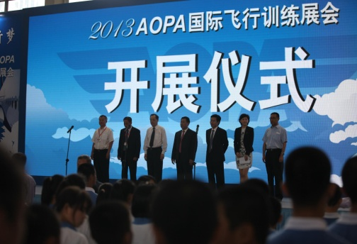
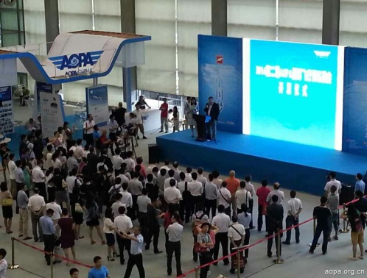
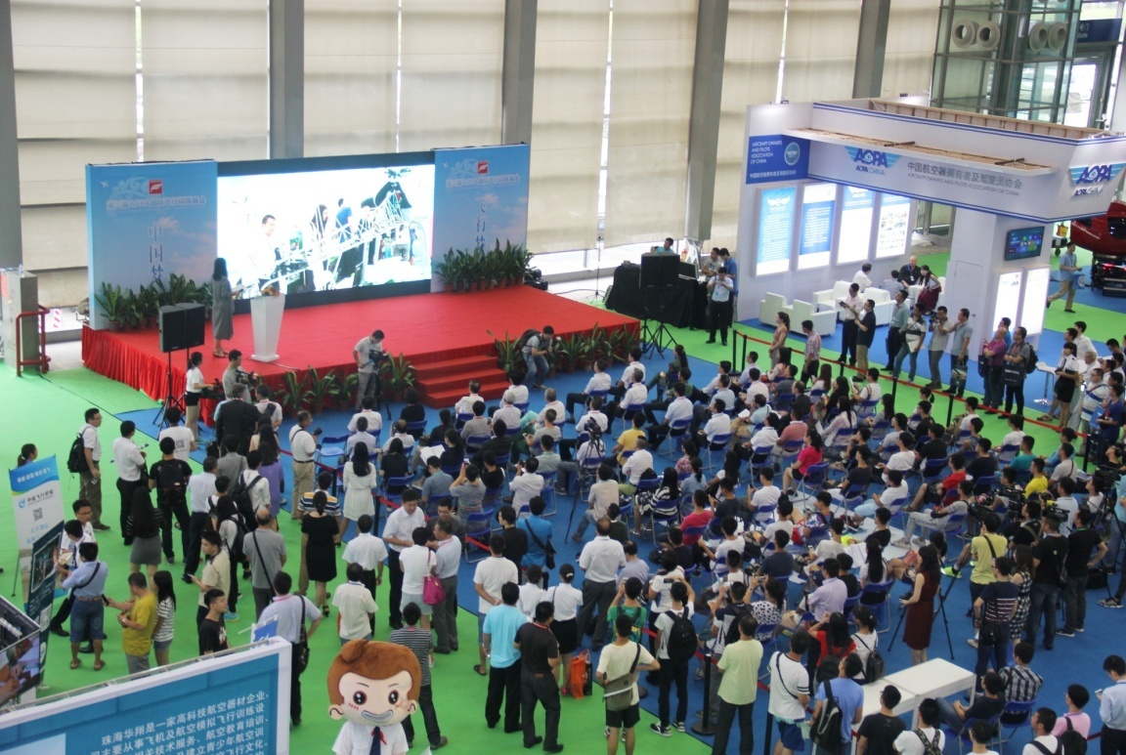
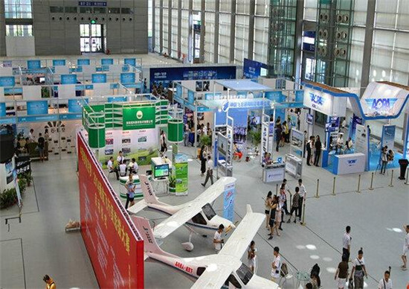
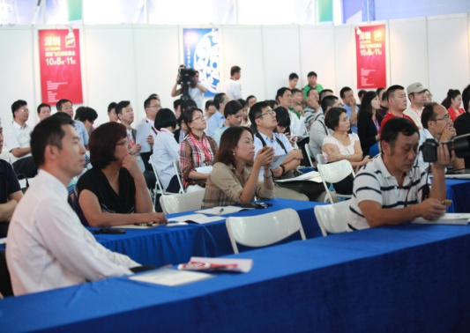
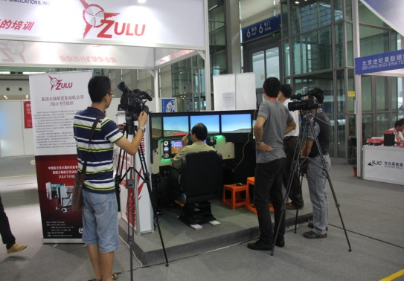
AOPA -China International Flight Training Exhibition
It becomes one of the most influential flying training exhibitions in the world. It gathers almost 300 exhibitors in five years. And attracts more than 30000 professional audiences from more than 30 countries. Communication platform for domestic and overseas’ flight training academies and institutions, flight simulators’ suppliers, and airlines.

Slide 13
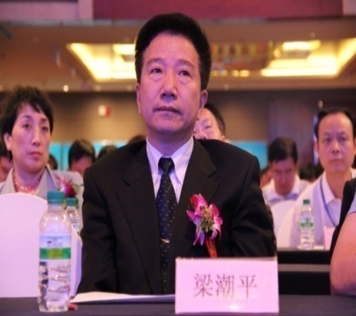
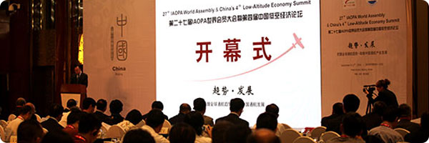
China Low-Altitude Airspace Forum
The objectives of the forum:
To enhance the mutual communication between local government and aviation enterprises.
To promote the development of general aviation industry policies in China

Slide 14
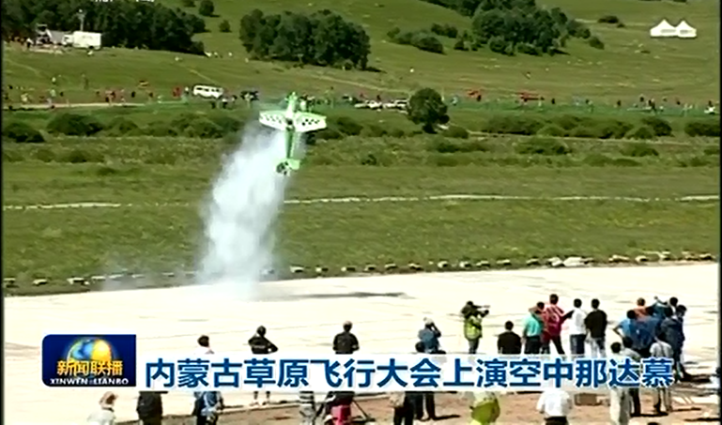
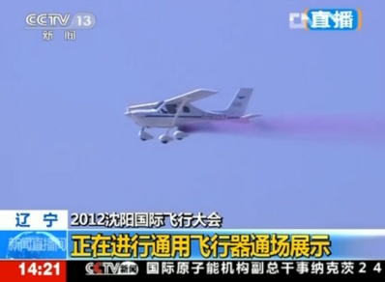
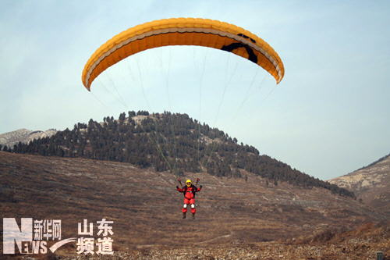
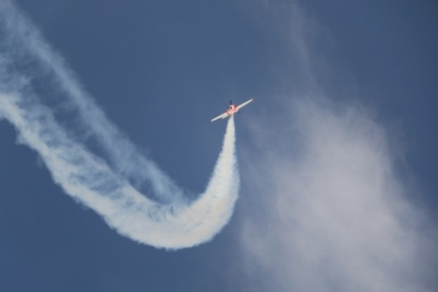
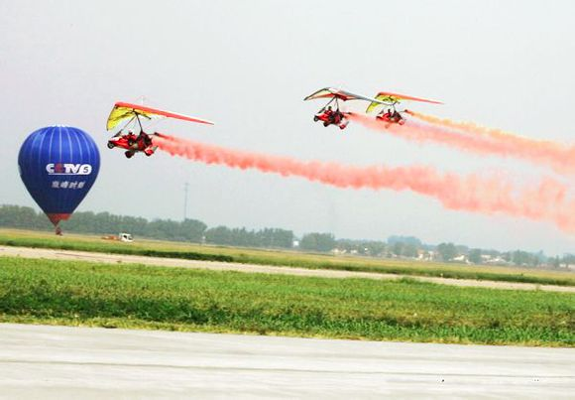
AOPA-China International Fly-Ins
AOPA-China International Fly-In adopts 'China Dream, Flying Dream' as our theme and holds parachuting performance, aerobatic performance, helicopter flying performancewing suit flying performance and other flying activities in Shenyang, Inner Mongolia, Yunnan province, Guizhou province and other places.

Slide 15
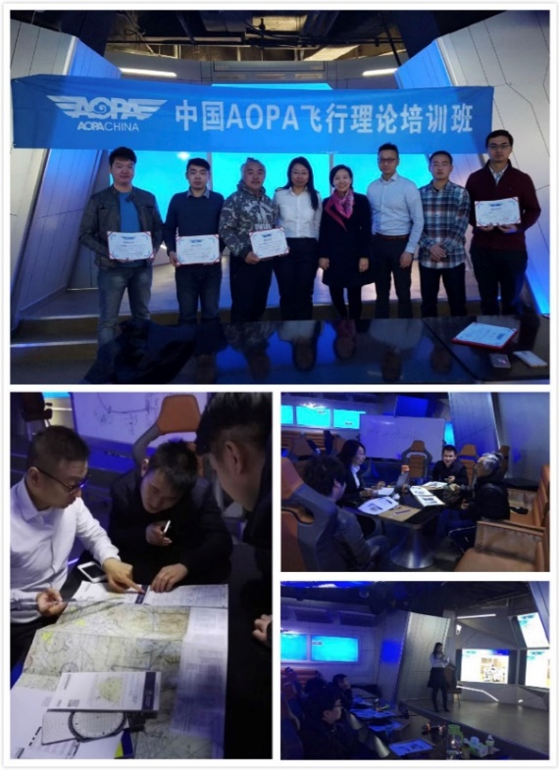
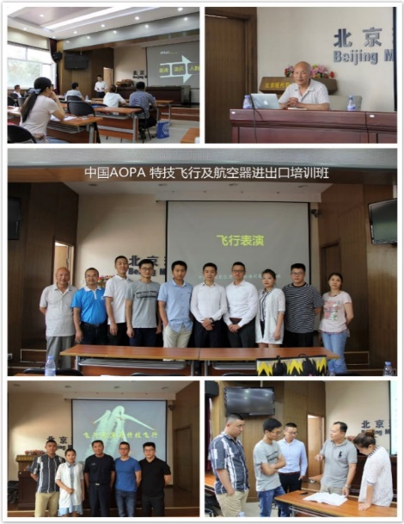
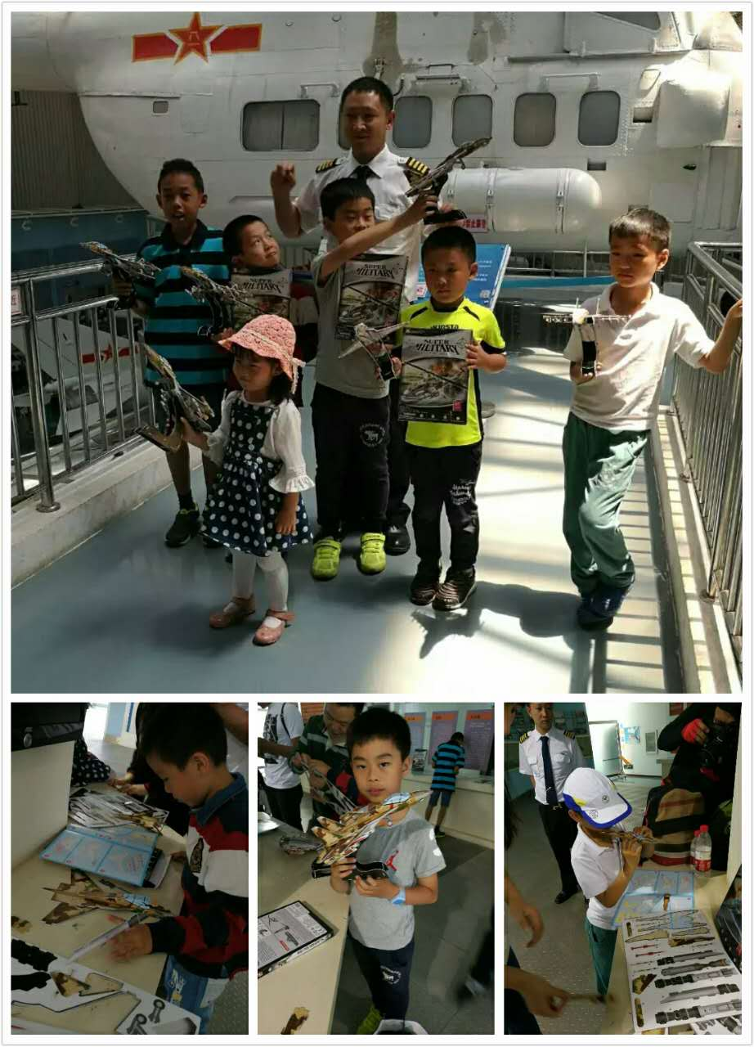
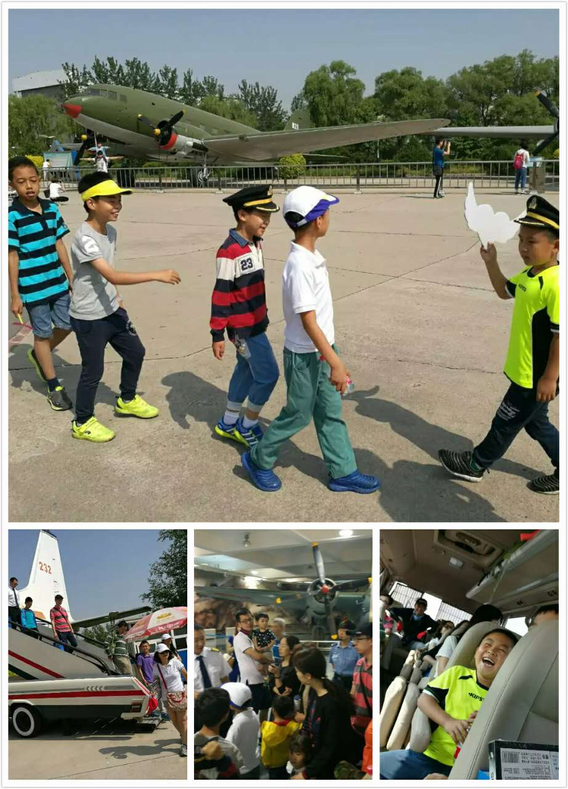
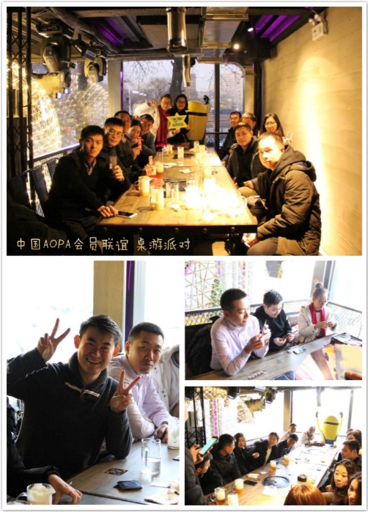
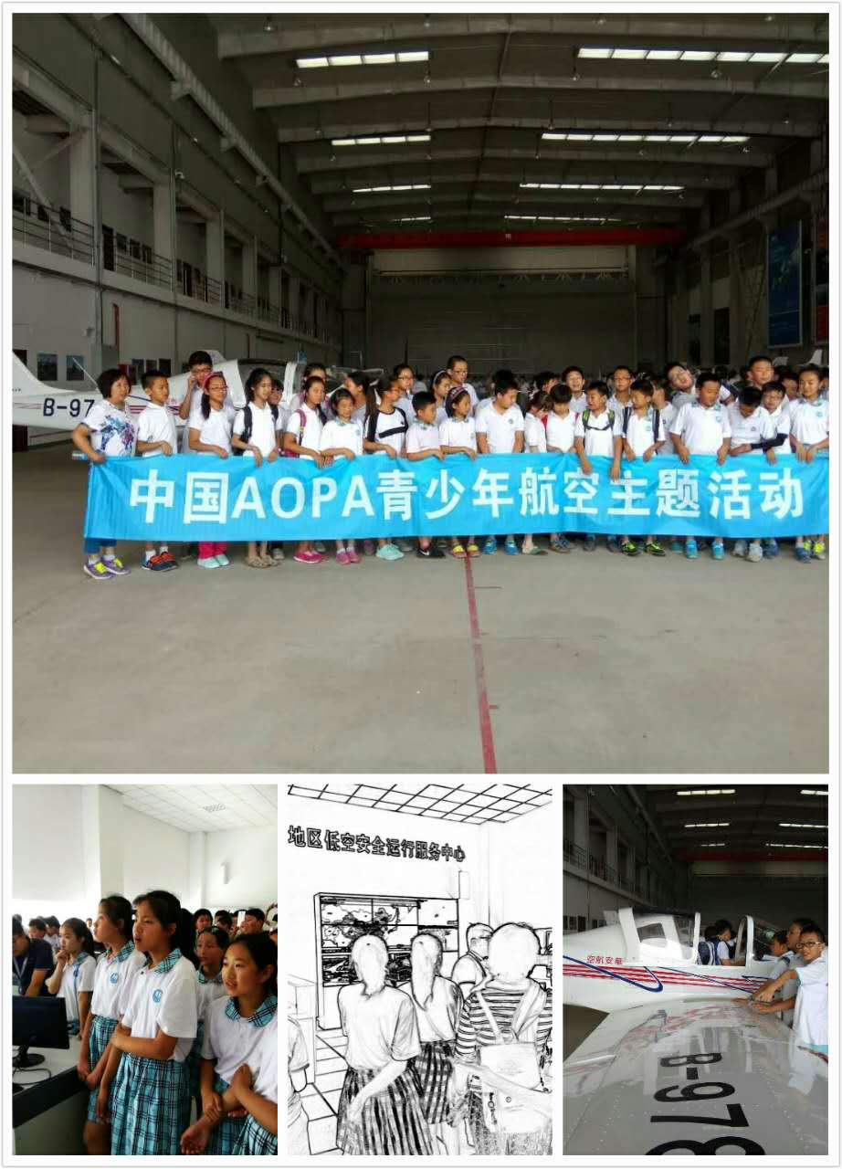
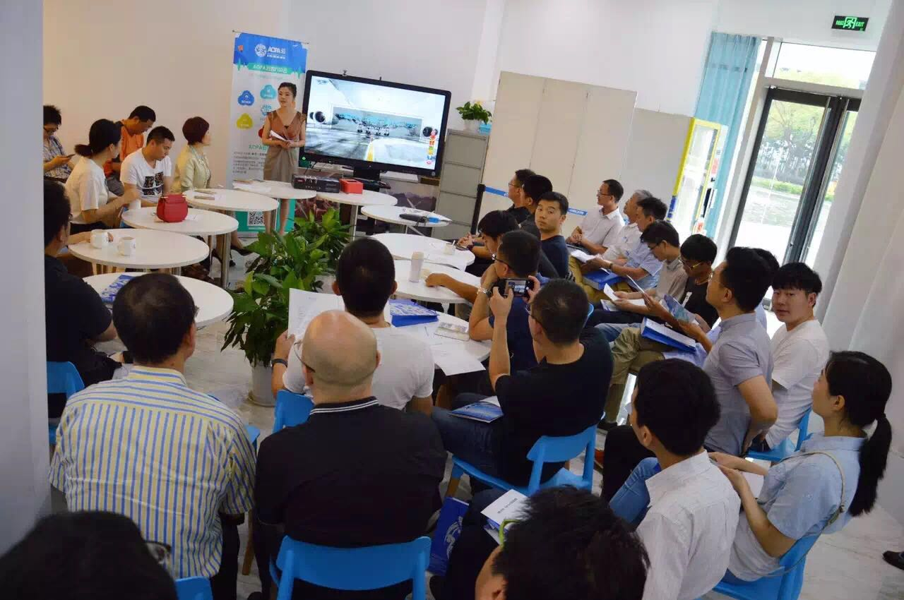
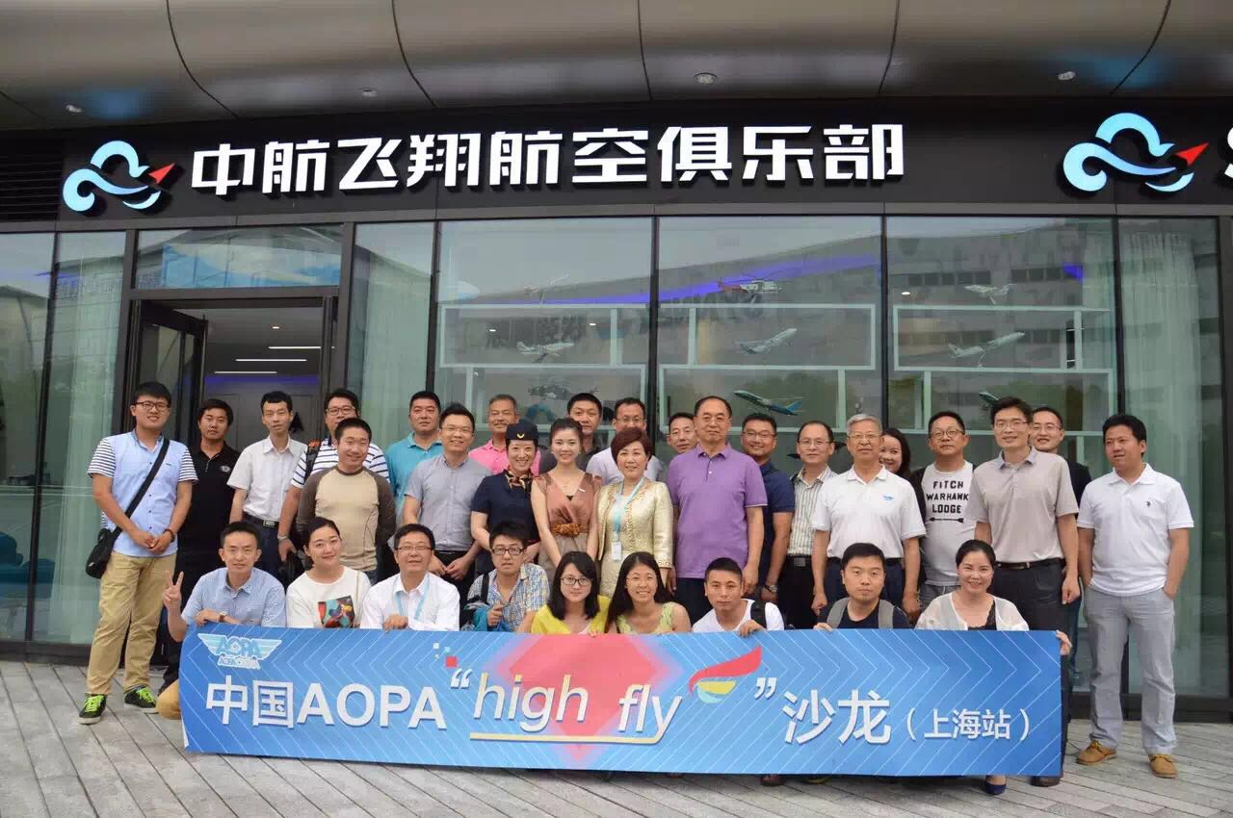
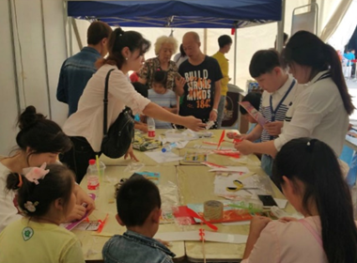
Photo Gallery of Our Member Events

Slide 16
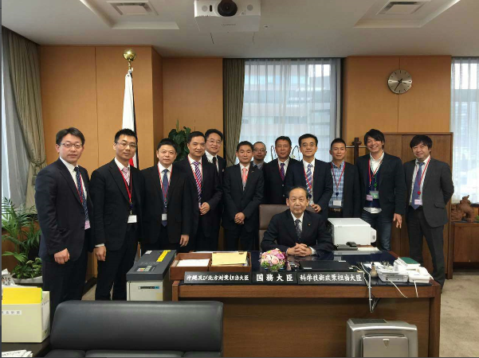
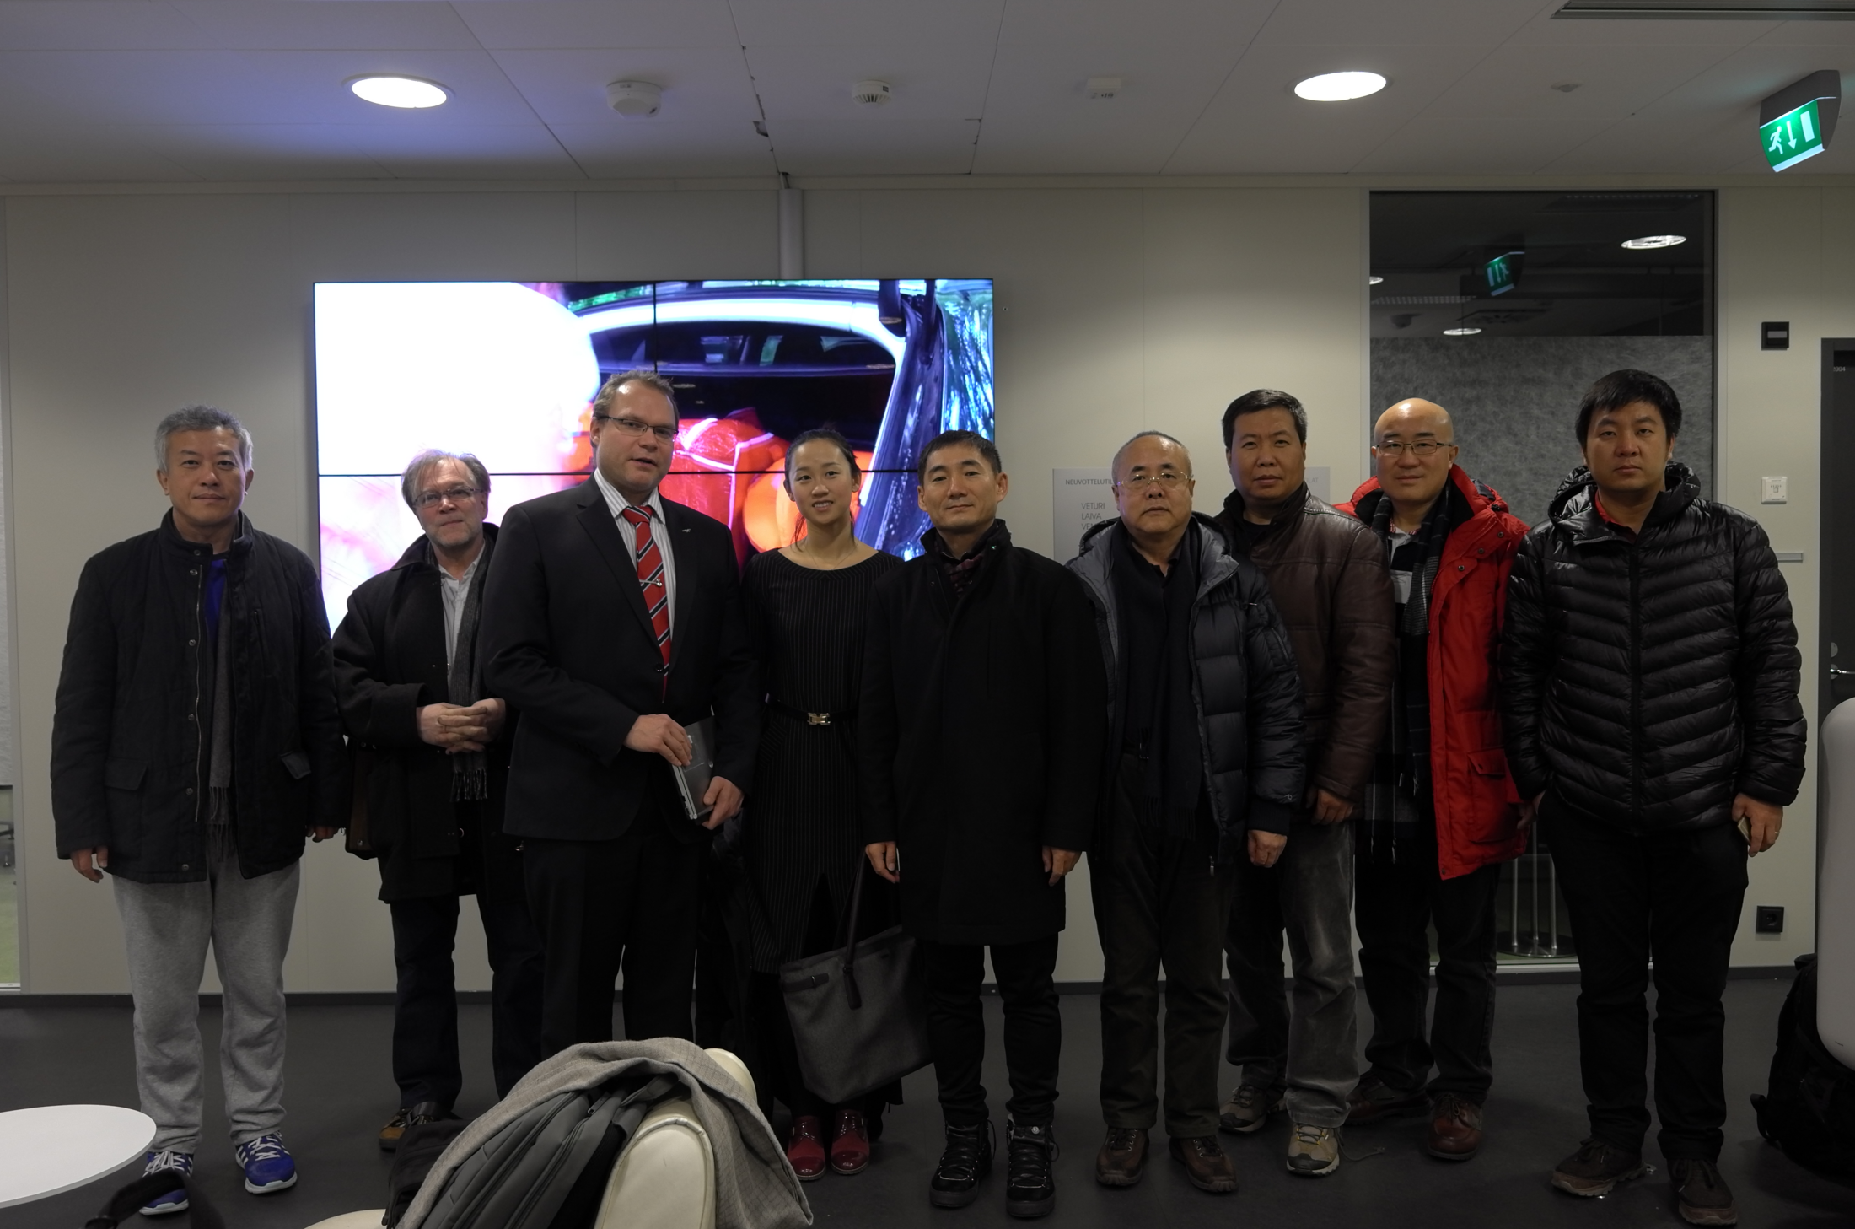
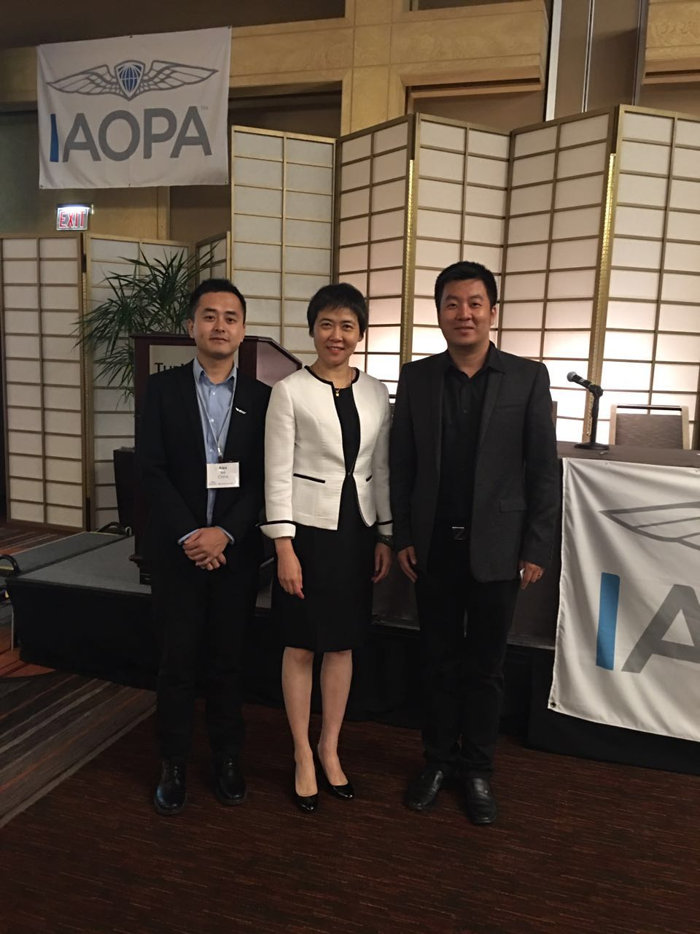
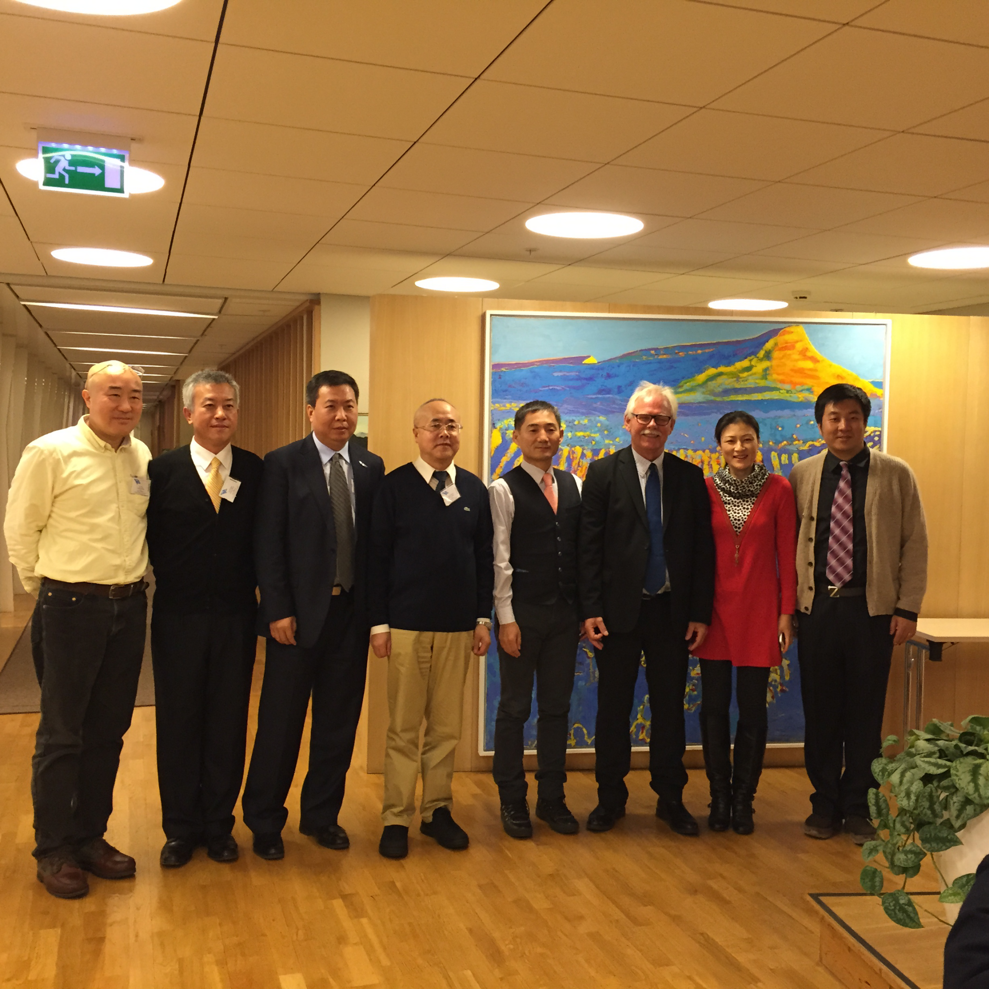
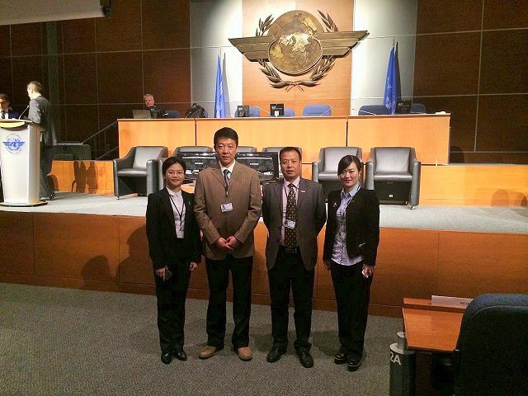
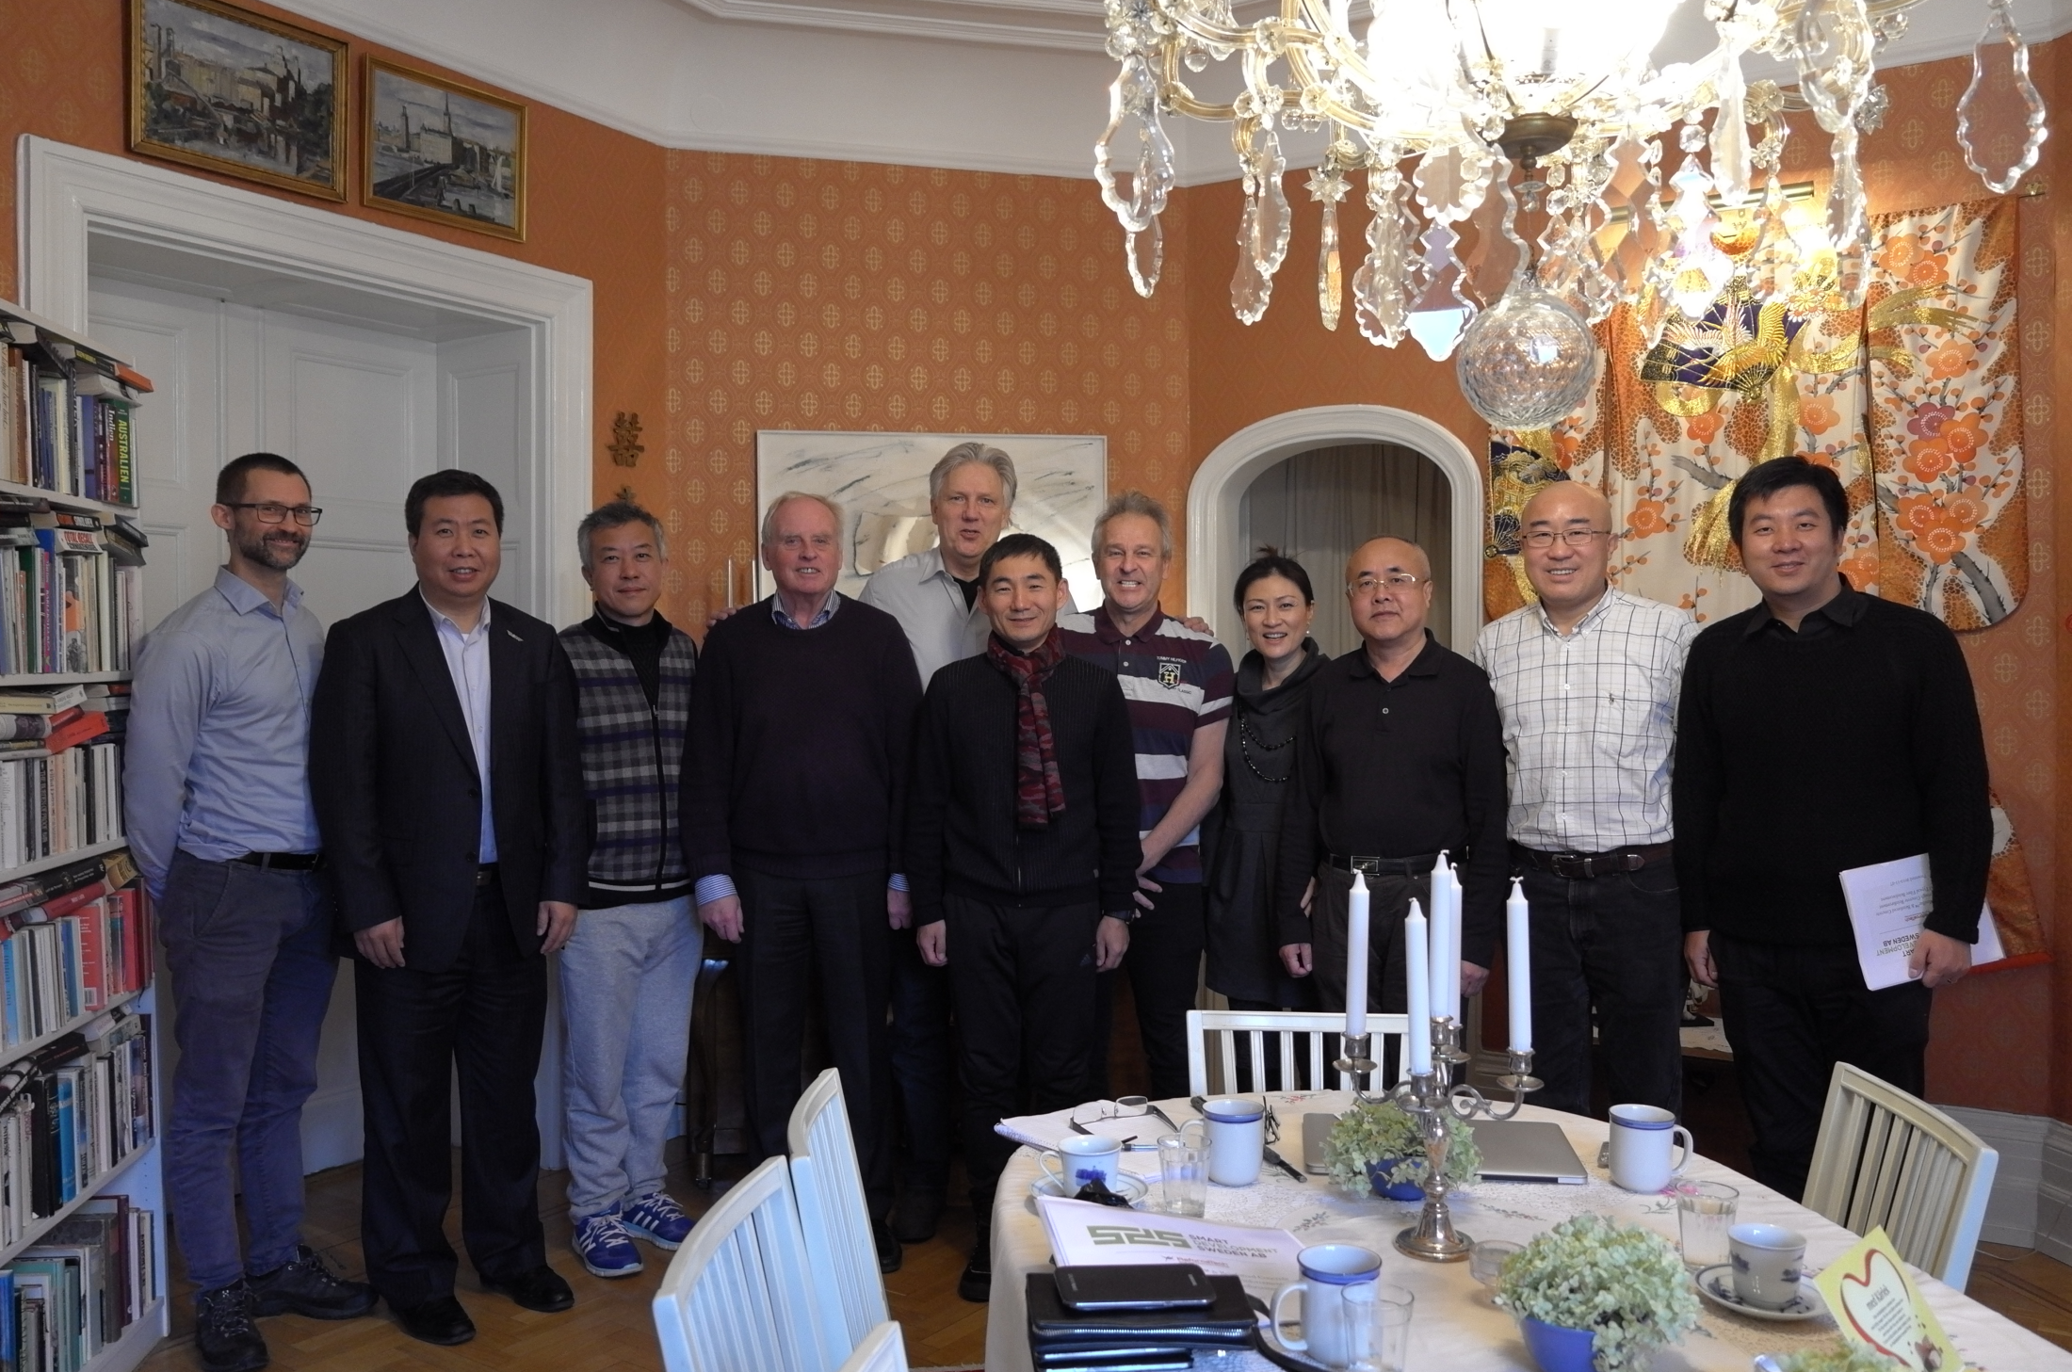
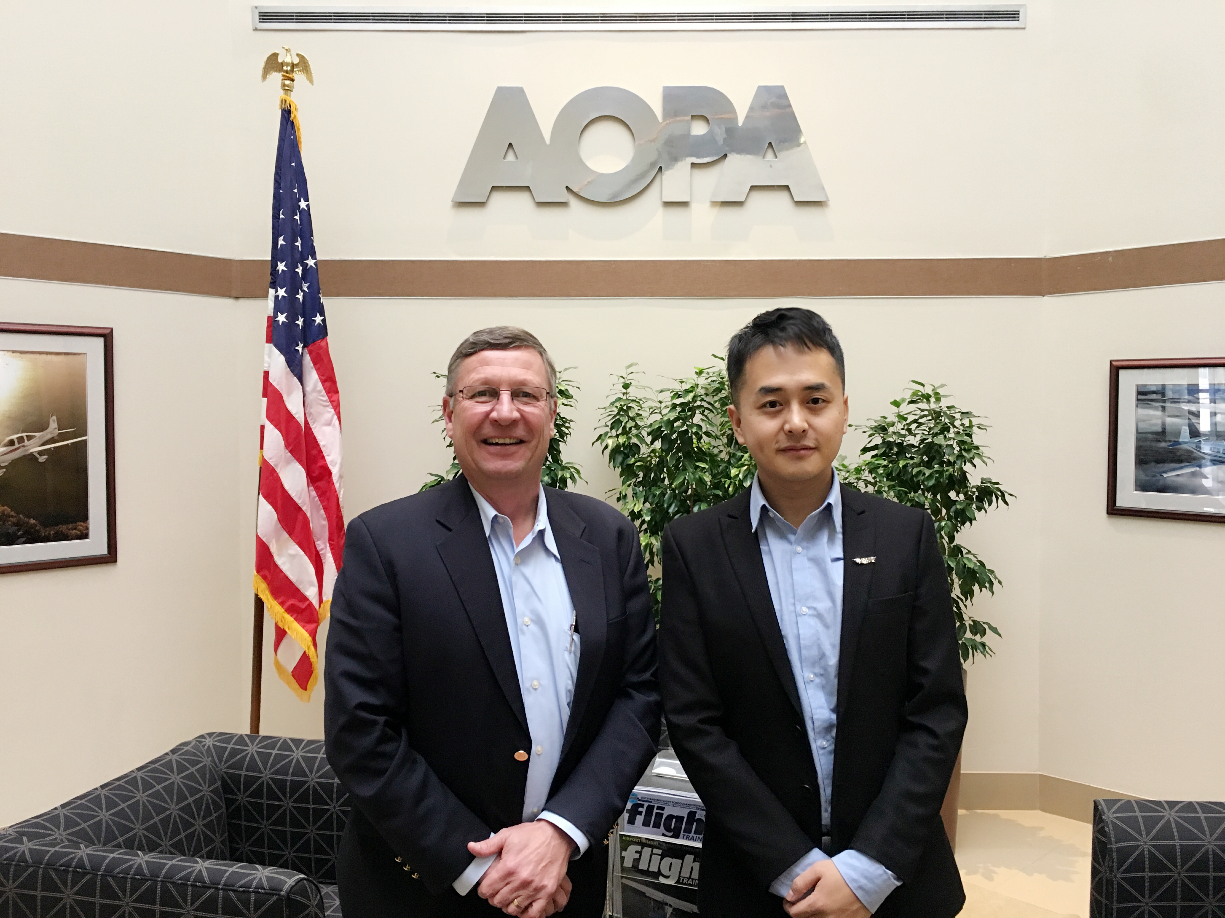
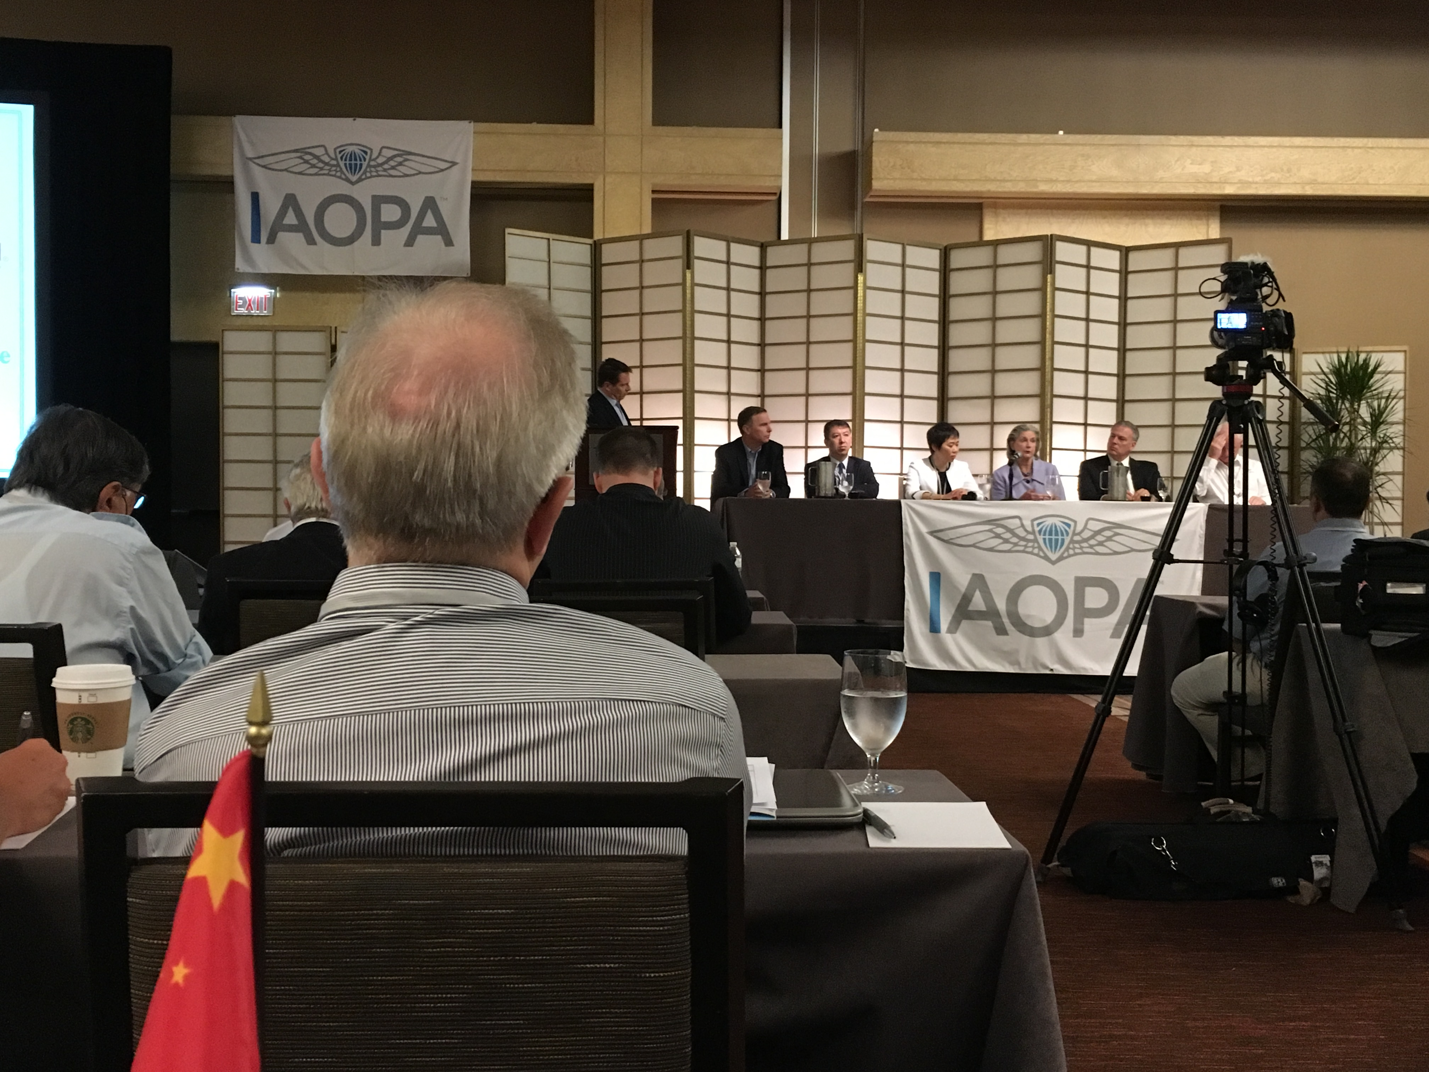
Photo Gallery of our Business Trip

Slide 17
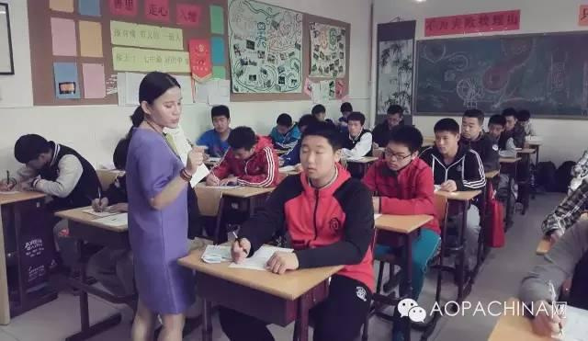
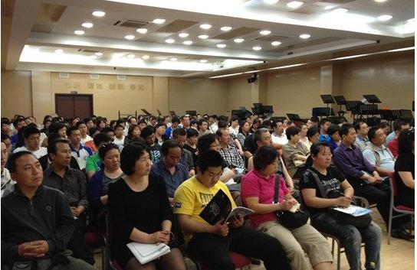
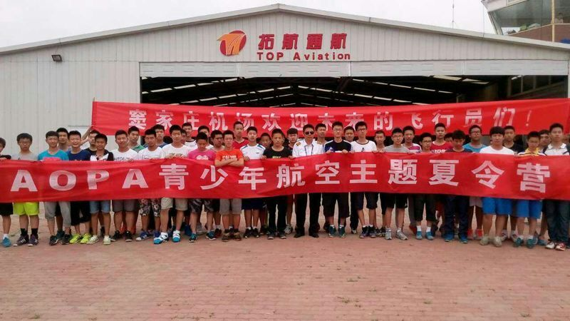
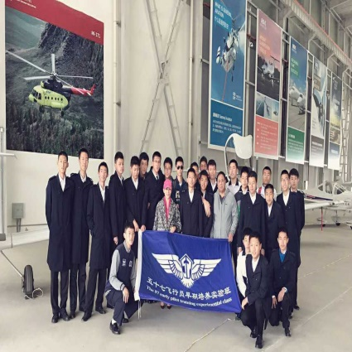
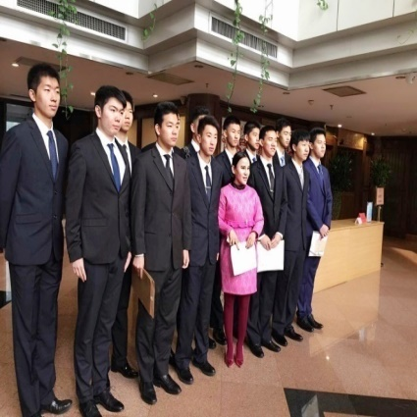
Young Eagle Plan
At present, this experimental class has already successfully held for six terms. More than 400 teenagers are trained and 50 of them successful get the private pilot license .

Slide 18
Chinese GA Market

Slide 19
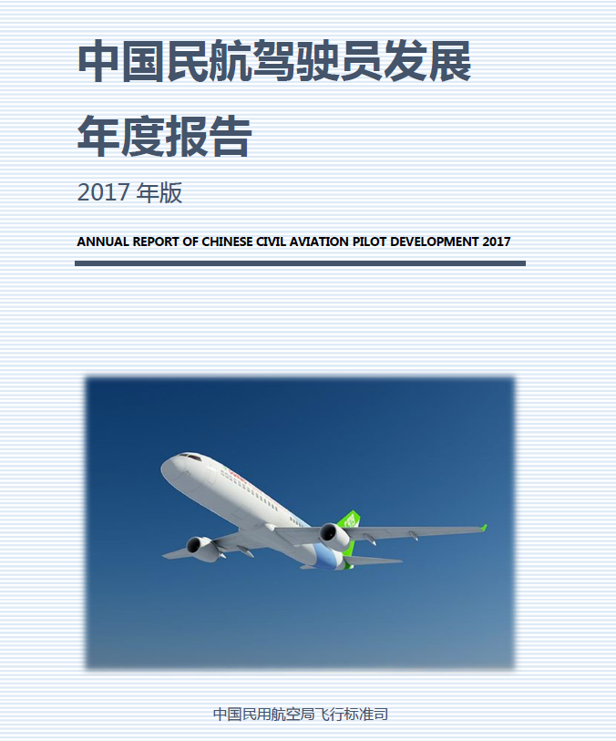
GA Market
According to the annual report of CAAC,
3326 pilots work in general aviation industry.
Among them 1733 pilots fly helicopters.
270 GA companies are operating in China.
1813 aircraft are used in GA industry.
100 certified GA airports all over China.
3326
270
1813
100

Slide 20
GA Market

Slide 21
GA Market
52%
The number of pilots will continue to increase as time goes by.

Slide 22
GA Market
55% increase from 2014

Slide 23
GA Market
28 airshows took place in China in 2017.
Almost 3 airshows every month.

Slide 24
International cooperation

Slide 25
International cooperation
Opportunities in general aviation
Possibilities in China’s market
Worldwide cooperation

Slide 26
Thank You.
Chinese GA Market
International Cooperation
Zhang Feng
Secretary General
AOPA-China

